Slide 1

New Pokémon Info!

Slide 2
Legendary Pokémon Classifier
Name: Nicole
Subject: Presentation for Ironhack’s Final Project

Slide 3






What are Legendary Pokémon? Why should we be interested?
HP
8 / 24
Hypothesis testing using Isolation Forest and EDA charts
HP
24 / 24
Presentation Outline
D
Data Cleaning and Preprocessing
HP
24 / 24
HP
24 / 24
Legendary Classifier Model Building
HP
10 / 16
Evaluation and Conclusion
HP
0 / 24
Choose a Pokémon.

Slide 4
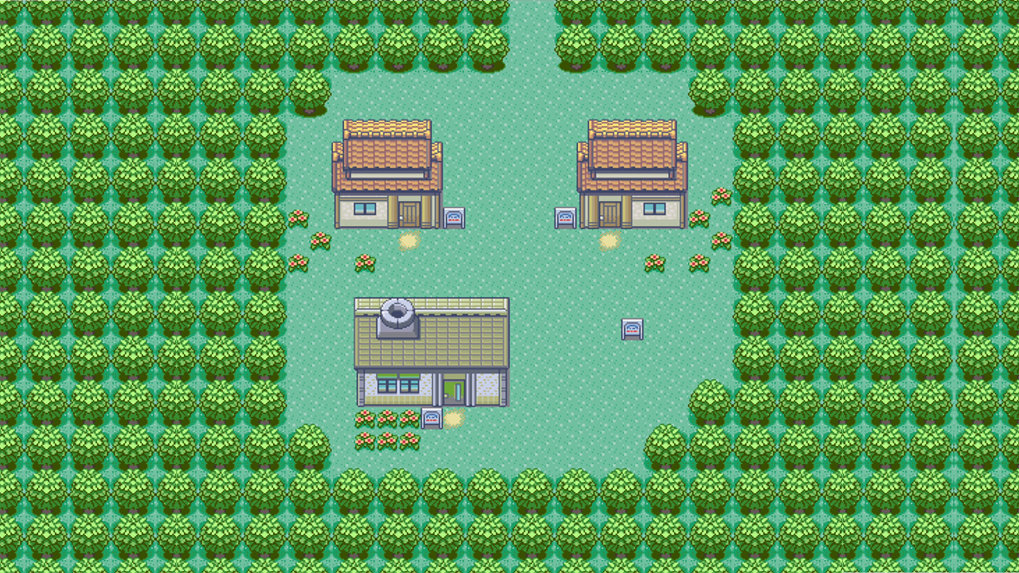
Legendary Pokémon
So, what are Legendary Pokémon?

Slide 5
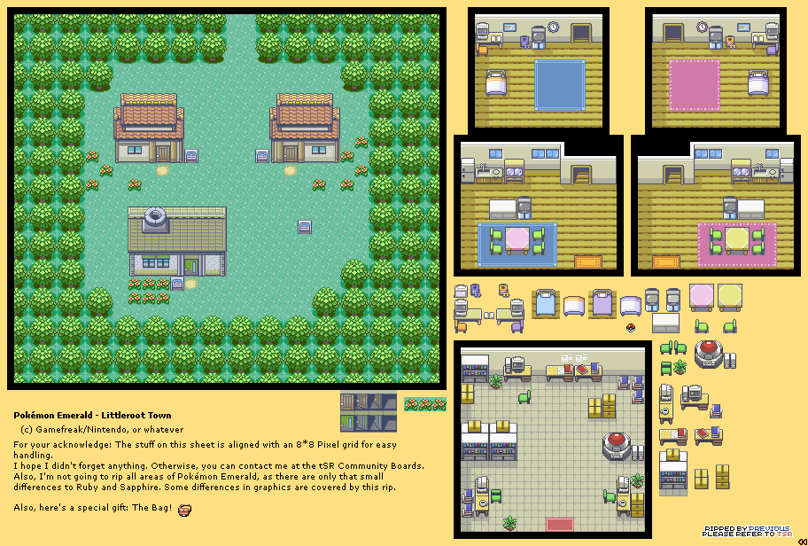


Legendary Pokémon are a special kind of Pokémon that are often considered rare and powerful. They are unique, with their own signature moves and abilities, and are often associated with myths and legends.
Examples of Legendary Pokémon:
Mew
Mewtwo
Suicune
Articuno
Zapdos
Moltres
Lugia
BACK

Slide 6









Cool
Key characters in games and the anime, thus highly sought after by trainers.
One of the main accomplishments in the game
They look pretty cool too!
Strong
They have unique abilities and moves that make them valuable additions to a trainer/player’s team.
Are much more powerful on average than ordinary Pokémon.
Rare
Can only be caught through specific methods or in some cases, special events and conditions
Very hard to come by and most importantly HARD AF TO CATCH !!!!!!!!!!!!!!!!!!!!!!!
BACK

Slide 7

Now, the question is: ARE THEY TRULY RARER AND MORE POWERFUL THAN NON-LEGENDARY POKEMON??????
DON’T TAKE MY WORD FOR IT :
GOTTA TEST ‘EM ALL!!!!!!
BACK
BACK

Slide 8



Topic
No01 ISLTN FRST. x 1
No06 HYPTHS TEST. x 2
No07 NARA’s MEMEs x 98
No16 LUISI JOKES x 8
No18 VAGUE LABS x 2
ISOLATION FOREST and HYPOTHESIS TESTING SELECTED.
No20 ATTN SPAN x 1
No21 BRKOUTROOMS x 99
CONFIRM
CHECK TAG
CANCEL

Slide 9
ISOLATION FOREST
Info
Unsupervised learning model that uses random decision trees
Isolates anomalies or rare occurrences in a data set
1
2
WTF do I need it for
To generate a list of anomaly scores for every Pokémon, the lower the score the rarer the Pokémon
Based on these scores I can test the hypothesis that Legendary Pokémon are rarer and more anomalous than non-Legendary Pokémon
3
Main

Slide 10
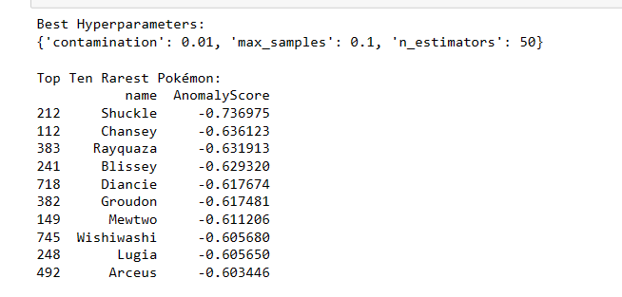





HYPOTHESIS TESTING
(H0): Legendary Pokémon are not rarer and more anomalous than non-legendary Pokémon.
(H1): Legendary Pokémon are rarer and more anomalous than non-legendary Pokémon
Snippet of Anomaly Scores
Conclusions
Test Type | Two sampled T test
Alpha (a) | 0.01
Confidence Level | 99%
Outcome | H0 rejected, h1 accepted
Note: Remove/delete the camera icon before inserting a picture in the placeholder
Main

Slide 11
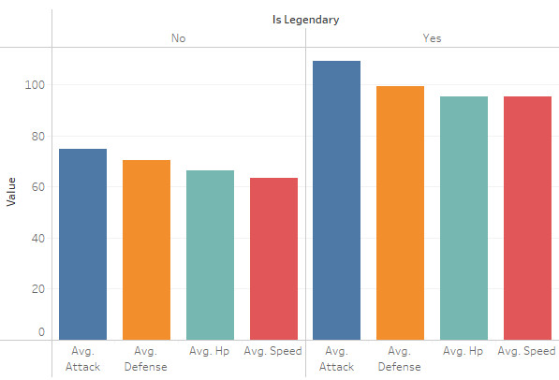
Note: You can use these 3 buttons (blue, green, orange) to navigate through the upcoming slides.
The buttons are also present in the upcoming slides (bottom right).
*In the next slides: “Main” button at bottom right returns to this specific slide
Comparison of Base Stats
Note: Remove/delete the camera icon before inserting a picture in the placeholder

Slide 12
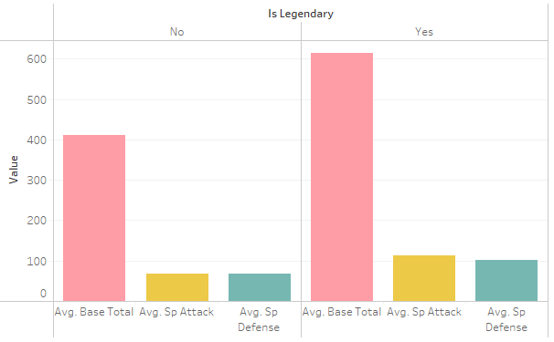
Note: You can use these 3 buttons (blue, green, orange) to navigate through the upcoming slides.
The buttons are also present in the upcoming slides (bottom right).
*In the next slides: “Main” button at bottom right returns to this specific slide
Comparison of Special Stats
Note: Remove/delete the camera icon before inserting a picture in the placeholder

Slide 13
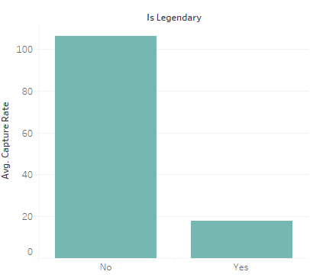
Note: You can use these 3 buttons (blue, green, orange) to navigate through the upcoming slides.
The buttons are also present in the upcoming slides (bottom right).
*In the next slides: “Main” button at bottom right returns to this specific slide
Capture Rate
Note: Remove/delete the camera icon before inserting a picture in the placeholder

Slide 14
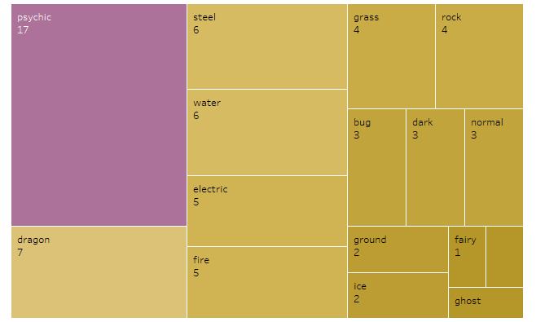
Note: You can use these 3 buttons (blue, green, orange) to navigate through the upcoming slides.
The buttons are also present in the upcoming slides (bottom right).
*In the next slides: “Main” button at bottom right returns to this specific slide
Most Common Elemental Type
Note: Remove/delete the camera icon before inserting a picture in the placeholder

Slide 15
Topic
No01HYPTHS TEST. x 2
No06 ISLTN FRST. x 1
No07 DATA CLNING. x 2
No16 PREPRCSSNG. x 5
No18 VAGUE LABS x 2
DATA CLEANING and PREPROCESSING selected.
No20 ATTN SPAN x 1
No21 NARA’s MEMEs x 98
CONFIRM
CHECK TAG
CANCEL

Slide 16
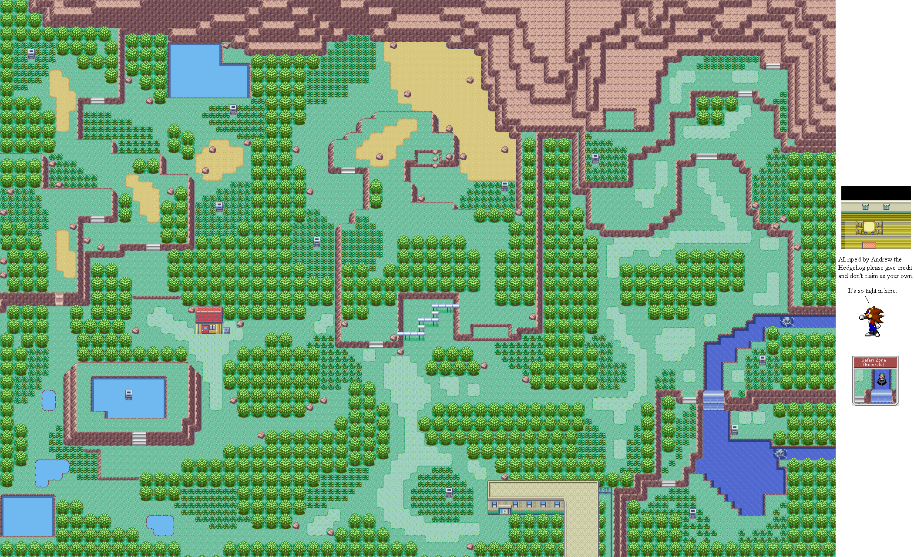

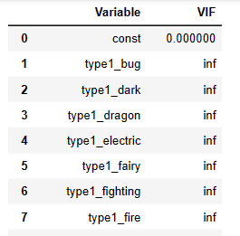



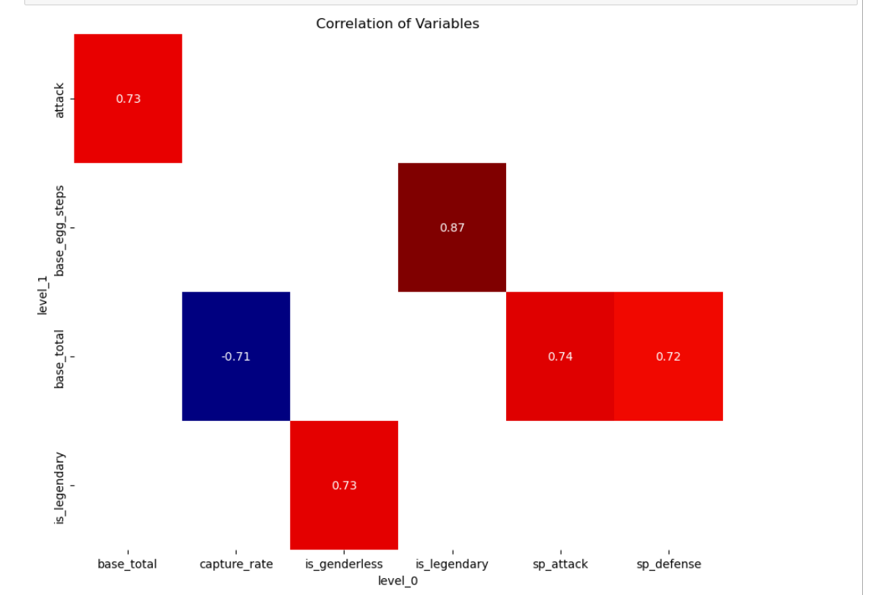
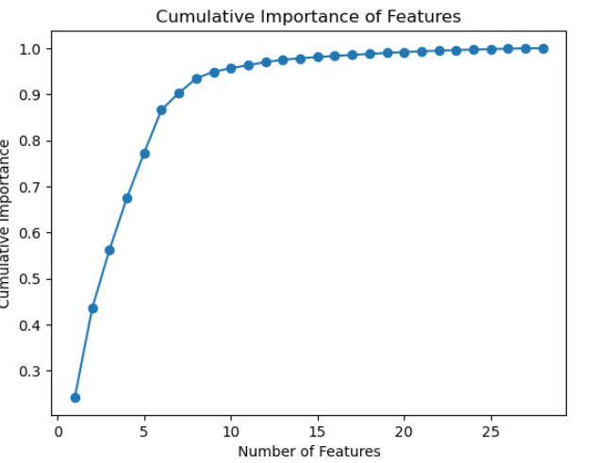

Domain knowledge
Dropping variables
Imputing nulls
Feature Engineering
Variance Inflation Factor (VIF)
Correlation Analysis
& Low Variance Filter
Feature Importance

Slide 17
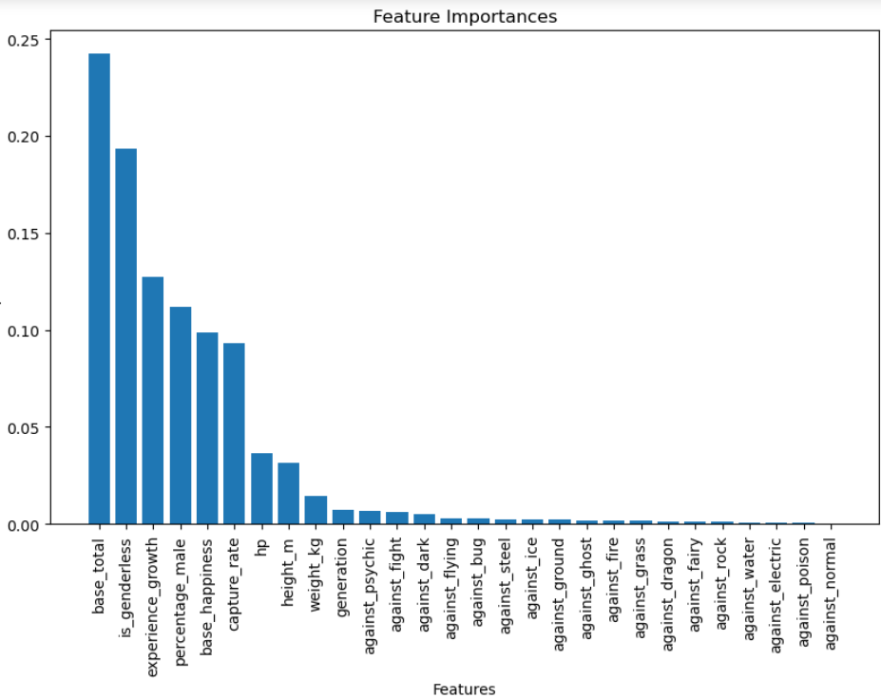
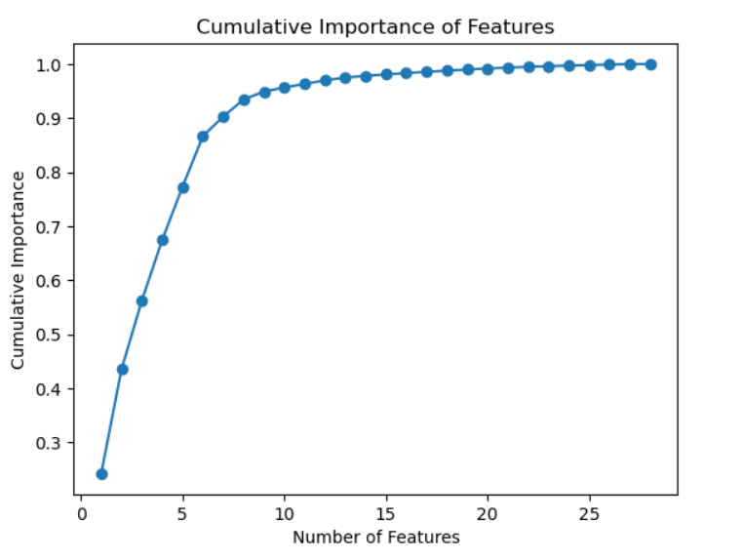
Some charts about Feature Importance
BACK

Slide 18



FINAL LIST OF ^{P}o^{K}é VARIABLES
is_legendary DEPENDENT
base_total INDEPENDENT
capture_rate INDEPENDENT
experience_growth INDEPENDENT
height_m Lv10
hp Lv23
SPICY
DRY
SWEET
BITTER
SOUR
weight_kg Lv23
is_genderless Lv23
FEEL
28
base_happiness

Slide 19
Topic
No01HYPTHS TEST. x 2
No06 ISLTN FRST. x 1
No07 DATA CLNING. x 2
No16 PREPRCSSNG. x 5
No18 BUILD MODEL x 1
MODEL BUILDING and MODEL EVALUATION selected.
No20 EVAL. MODEL x 1
No21 NARA’s MEMEs x 98
CONFIRM
CHECK TAG
CANCEL

Slide 20
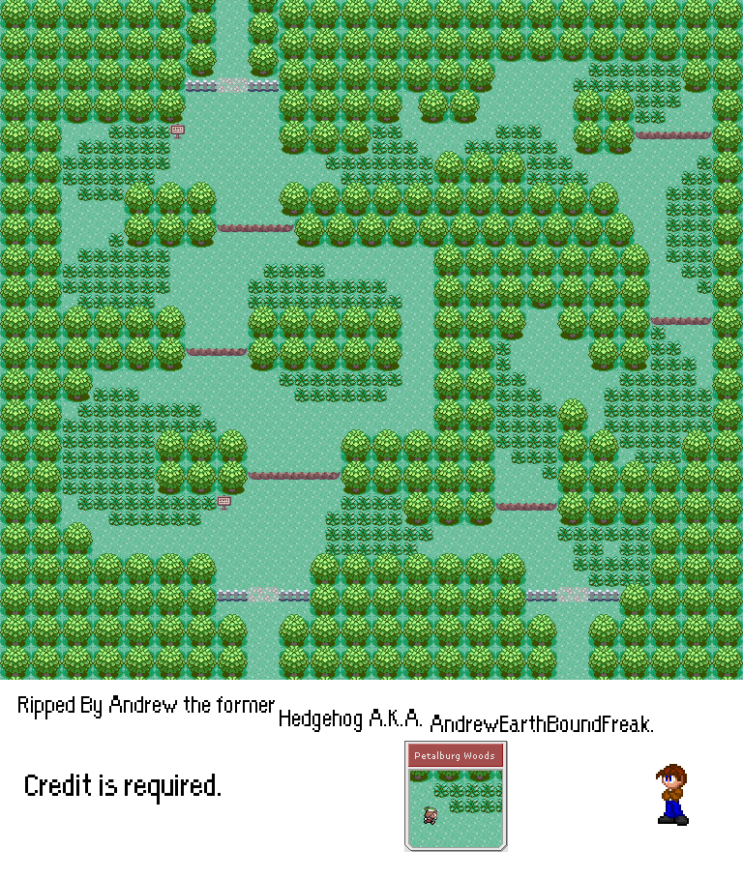

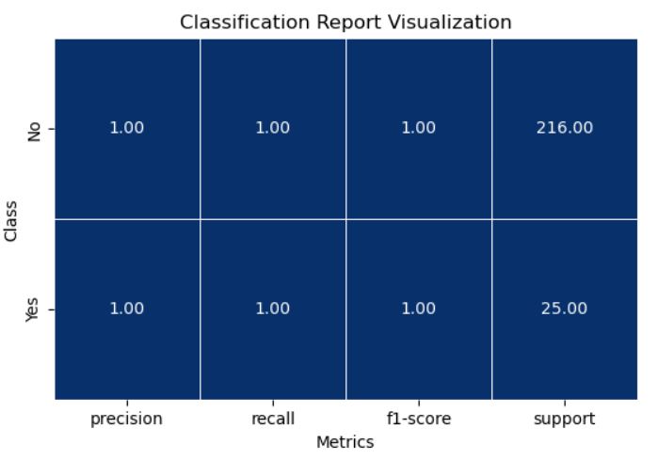





Logistic Regression Model
SCALING METHOD: STADARD SCALER
SMOTE VS RANDOM OVERSAMPLER?
SMOTE
BACK

Slide 21



Other Binary Classification Models
LOG TRANSFORM BEFORE BUILDING OTHER MODELS!!
KNEIGHBOURSCLASSIFIER
DECISION TREE CLASSIFIER
GAUSSIAN NAÏVE BAYES
SVM and KNeighborsClassifier are sensitive to skewed data.
Log transforming variables is not necessary for logistic regression.
Easier to distinguish effect of transformations
Lesser variables to transform after dropping

Slide 22




Is it OVERFITTED?
YES!!
NO!!
Repeated Stratified Folds Cross Validation testing across all models shows
similar mean accuracy scores
2. Other scores within the classification report are identical across the board
3. THE DATA IS ARTIFICIAL!!!!!

Slide 23
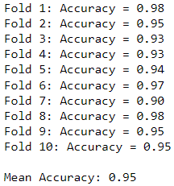

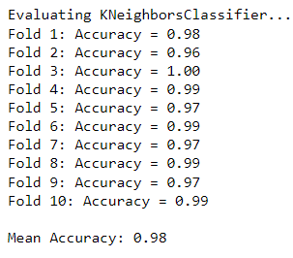
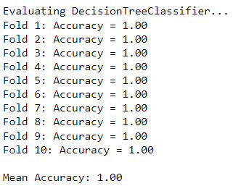

Results for Logistic Regression k=10
Stratified KFolds Cross Validation
Results for Other Models k=10

Slide 24
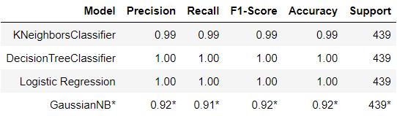
The Stratified Folds Cross Validation indicates there is no overfitting -- rather, the almost perfect scores can be explained by the artificial nature of the data
Classification Reports after Hyperparameter Tuning
More time needed to tune the GaussianNB hyperparameters
There is sufficient material to build a Streamlit App!
CONCLUSIONS

Slide 25
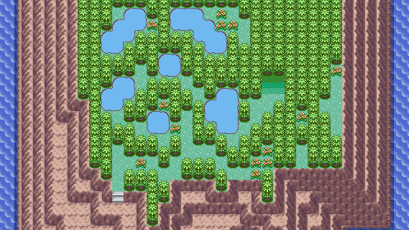



Future Improvements
Trying out Ensemble Models
INCORPORATING POKEMON DATA FROM OTHER GENERATIONS BEYOND 7
Building A Legendary Pokémon Recommender

Slide 26
Thank you for Exploring
Nicole’s Pokédex!
See you next time!
Status: logging out…

